Slide 1




SMART INDIA HACKATHON 2026
Problem Statement ID – SIH26006
Problem Statement Title- Development of an Intelligent Freight Forecasting Model for Optimized Vessel Chartering and Bulk Cargo Procurement From Overseas to East Cost of India
Theme- Transportation and Logistics
PS Category- Software
Team ID-
Team Name (Registered on portal)- Hackverse

Slide 2
SMARTFREIGHT AI
Hackverse
PROBLEM ADDRESSED
PROPOSED SOLUTION
INNOVATIONS
Reactive daily/spot
chartering
Freight-rate uncertainty
Wrong vessel selection
Port draft/size restrictions
Unpredictable congestion
& waiting time
High voyage and idle costs
Difficulty planning short/medium-term
contracts.
Freight-rate forecasting
Optimal charter timing
Vessel & port compatibility
AIS-based ETA monitoring
Waiting-time prediction
Total voyage-cost calculation
Charter Now vs Wait decision
Spot / Short / Medium-term contract recommendation
One integrated decision-support system
Combines Forecast + Vessel
+ Port + AIS + Waiting + Cost
Uses the more restrictive port for vessel selection
Provides Charter vs Wait decision
Connects forecasting directly to contract strategy
From market monitoring intelligent chartering decision
@SIH Idea submission- Template
2
Notes:
2

Slide 3
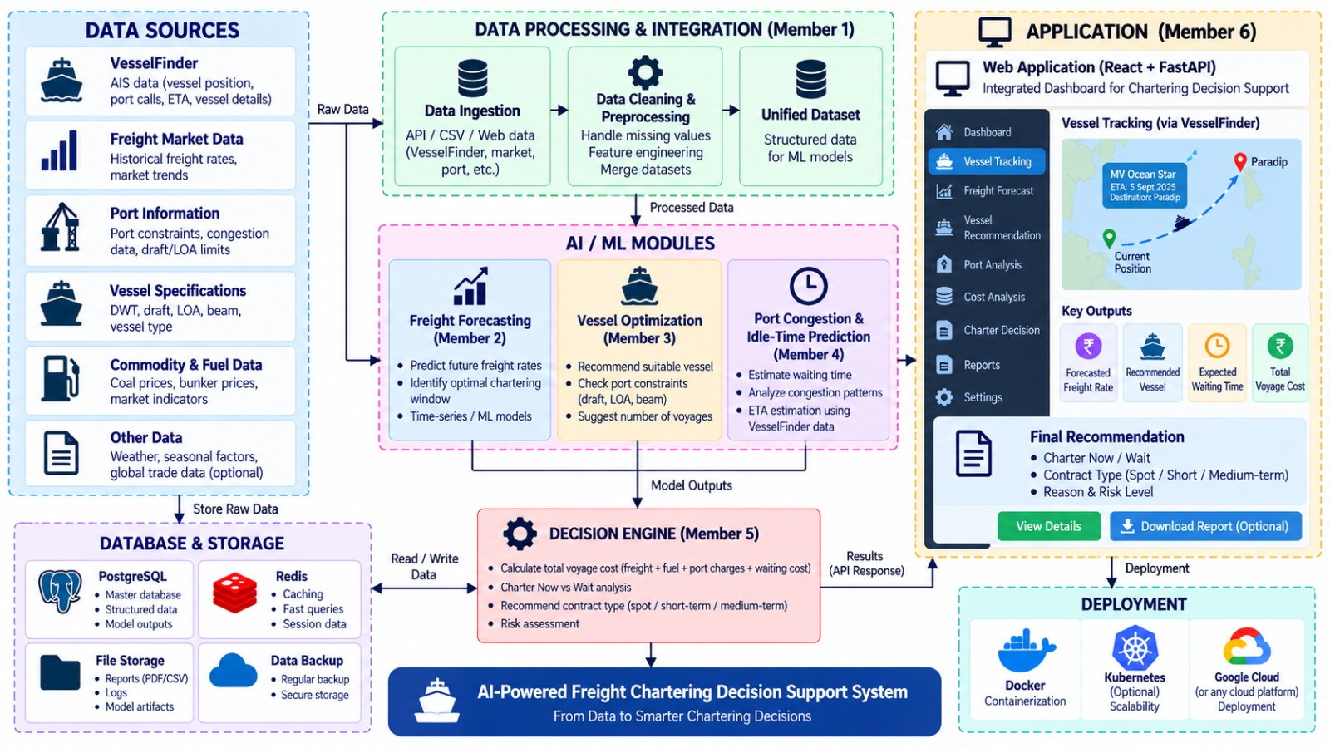
TECHNICAL APPROACH
Hackverse
@SIH Idea submission- Template
3
Notes:
3

Slide 4



FEASIBILITY AND VIABILITY
Hackverse
Feasibility
Technically feasible using Python, ML, FastAPI and React.
Available data from freight markets, port databases and VesselFinder.
Scalable architecture supports future ports and vessel types.
Prototype-friendly with historical data and API-based vessel tracking.
Viability
Reduces freight & idle-time costs through better charter decisions.
Improves operational efficiency with vessel and port matching.
Supports better contract planning — Spot / Short-term / Medium-term.
Practical business value for bulk cargo procurement and chartering.
User-friendly application provides forecasts, recommendations and downloadable
reports.
Potential Challenges
Data Quality – Reliable freight & AIS data
Market Volatility – Unpredictable rate fluctuations
ETA Uncertainty – Delays & inaccurate vessel data
Strategies for Mitigation
Data Validation – Clean & cross-check
multiple data sources
Dynamic Forecasting – Regularly update models
with new data
AIS Backup – Combine historical + simulated/live AIS data
@SIH Idea submission- Template
4
Notes:
4

Slide 5

IMPACT AND BENEFITS
Hackverse
IMPACTS
BENEFITS
Economic: Lower freight and voyage costs.graph text
and Reduced vessel idle time and port waiting.
Accurate Freight Forecasting and
Optimal Vessel Selection
Supply Chain: Improved reliability of bulk cargo
movement and Better long-term chartering
and procurement planning.
Better Chartering Timing and
Reduced Waiting & Idle Time
Environmental : Better long-term chartering and
procurement planning.
Data-Driven Decisions,Contract Optimization
and Centralized Application & Reports
@SIH Idea submission- Template
5
Notes:
5

Slide 6
RESEARCH AND REFERENCES
Hackverse
Predicting Ship Waiting Times Using Machine Learning for Enhanced Port Operations (2025)
Integrating Vessel Arrival Time Forecasting into Berth Allocation Decisions (2026)
Time Series Forecasting Methods for the Baltic Dry Index (2021)
Baltic Dry Index Forecast Using Financial Market Data: ML + SHAP (2025)
Shipping News Sentiment Meets Multiscale Decomposition (2026)
Optimal Tanker Chartering Decisions with Spot Freight Rate Dynamics (2013)
Forecasting Spot Freight Rates Using VECM in the Dry Bulk Market
Can Maritime Big Data Be Applied to Shipping Industry Analysis? — Vessel Sizes of Dry Bulk Carriers
Developing a Vessel Size Selection Model by Commodity for Dry Bulk Carriers (2020)
In-port Multi-ship Routing and Scheduling Problem with Draft Limits- Research Gate.
@SIH Idea submission- Template
6
Notes:
6

Slide 7
IMPORTANT INSTRUCTIONS
Please ensure below pointers are met while submitting the Idea PPT:
Kindly keep the maximum slides limit up to six (6). ( Including the title slide)
Try to avoid paragraphs and post your idea in points /diagrams / Infographics /pictures
Keep your explanation precise and easy to understand
Idea should be unique and novel.
You can only use provided template for making the PPT without changing the idea details pointers (mentioned in previous slides).
You need to save the file in PDF and upload the same on portal. No PPT, Word Doc or any other format will be supported.
Note - You can delete this slide (Important Pointers) when you upload the details of your idea on SIH portal.
@SIH Idea submission- Template
7
Notes:
7

